Slide 1
Pancancer Network Analysis reveals key Master Regulators for a Cancer Invasiveness
Mahesh Jethalia (IIT KGP)
Halima Bensmail (Qatar Computing Research Institute)
Raghvendra Mall (Qatar Computing Research Institute, SJCRH-ALSAC)
Tumor invasiveness is infiltrating form of cancer, where it has developed and grown into surrounding healthy tissues.
Tumor invasiveness reflects many biological changes associated with tumorigenesis, progression, metastasis, and drug resistance (Bi et al, JTRM, 2021).
Bi et al, 2021 identified common invasiveness-associated dysregulated molecular features between high- and low-invasiveness groups across multiple cancers.
Biological mechanisms underlying invasiveness and metastasis are largely an enigma.
Invasiveness score defined based on 24 gene signature (Geeleher et al).
Based on OS several TCGA cancers have prognostic association with invasiveness:
Invasiveness Phenotype - OV, LUAD, STAD, BLCA, COAD, KIRC, MESO, PAAD, KIRP, LGG
Invasiveness High ↓ survival, Invasiveness Low ↑ survival
Goal is to perform master regulator analysis and identify MRs specific to Invasiveness High and Low phenotypes & associated downstream targetable pathways.

Slide 2

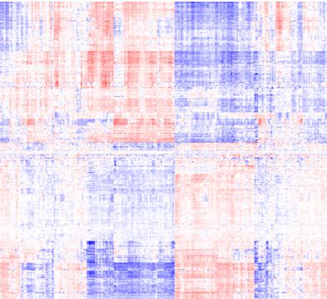

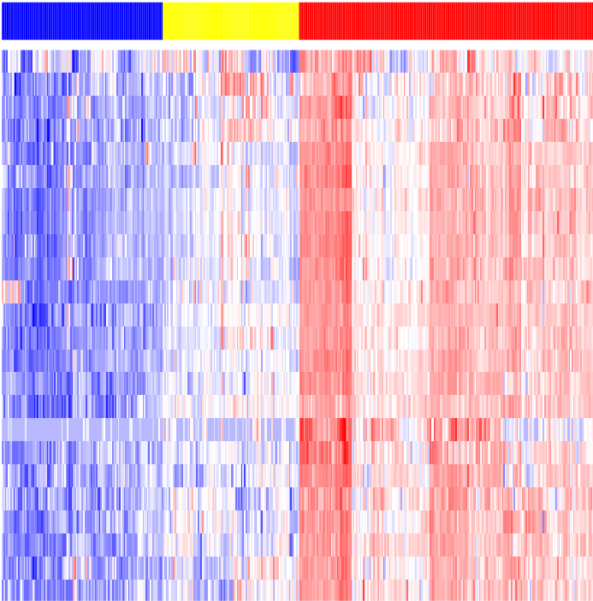
Graphical Abstract
TCGA
RNASeq data
- 10 cancers
- 2200 patients
Regularized gradient boosting machines (RGBM)
Visualization of most significant MRs
Transcription Regulator (TR)
INV High
INV Low
Top MRs
High
Normalization & log2 transformation
Regulated Targets
Low
INV Classification
Samples
INV Low
INV High
Differential master regulator (MR) activity estimation
Pathway enrichment analysis via ConsensusPathDB
Diff. MRl average activity in INV High versus INV Low
Expression value
Activity in INV Low
0
MRs
Enriched pathways
INV Genes
0
Samples
Activity in INV High

Slide 3

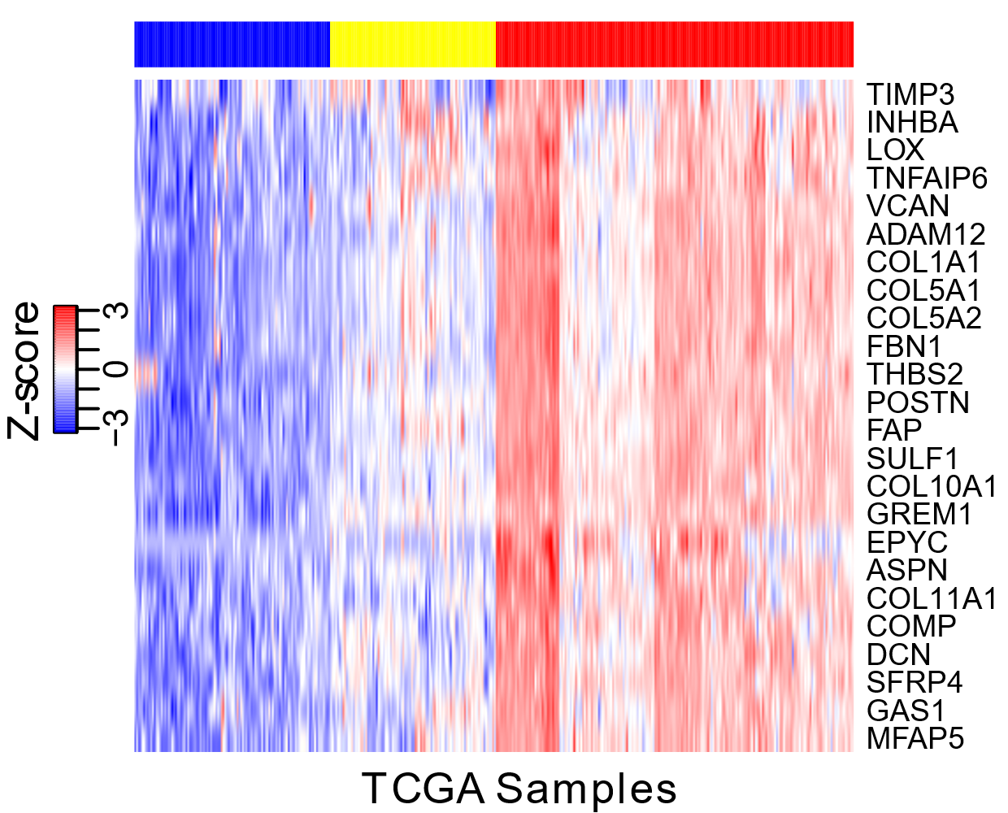
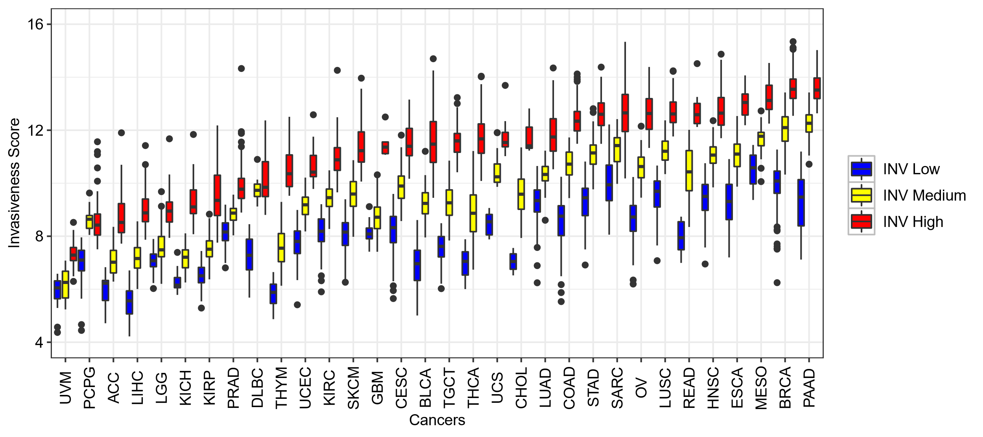
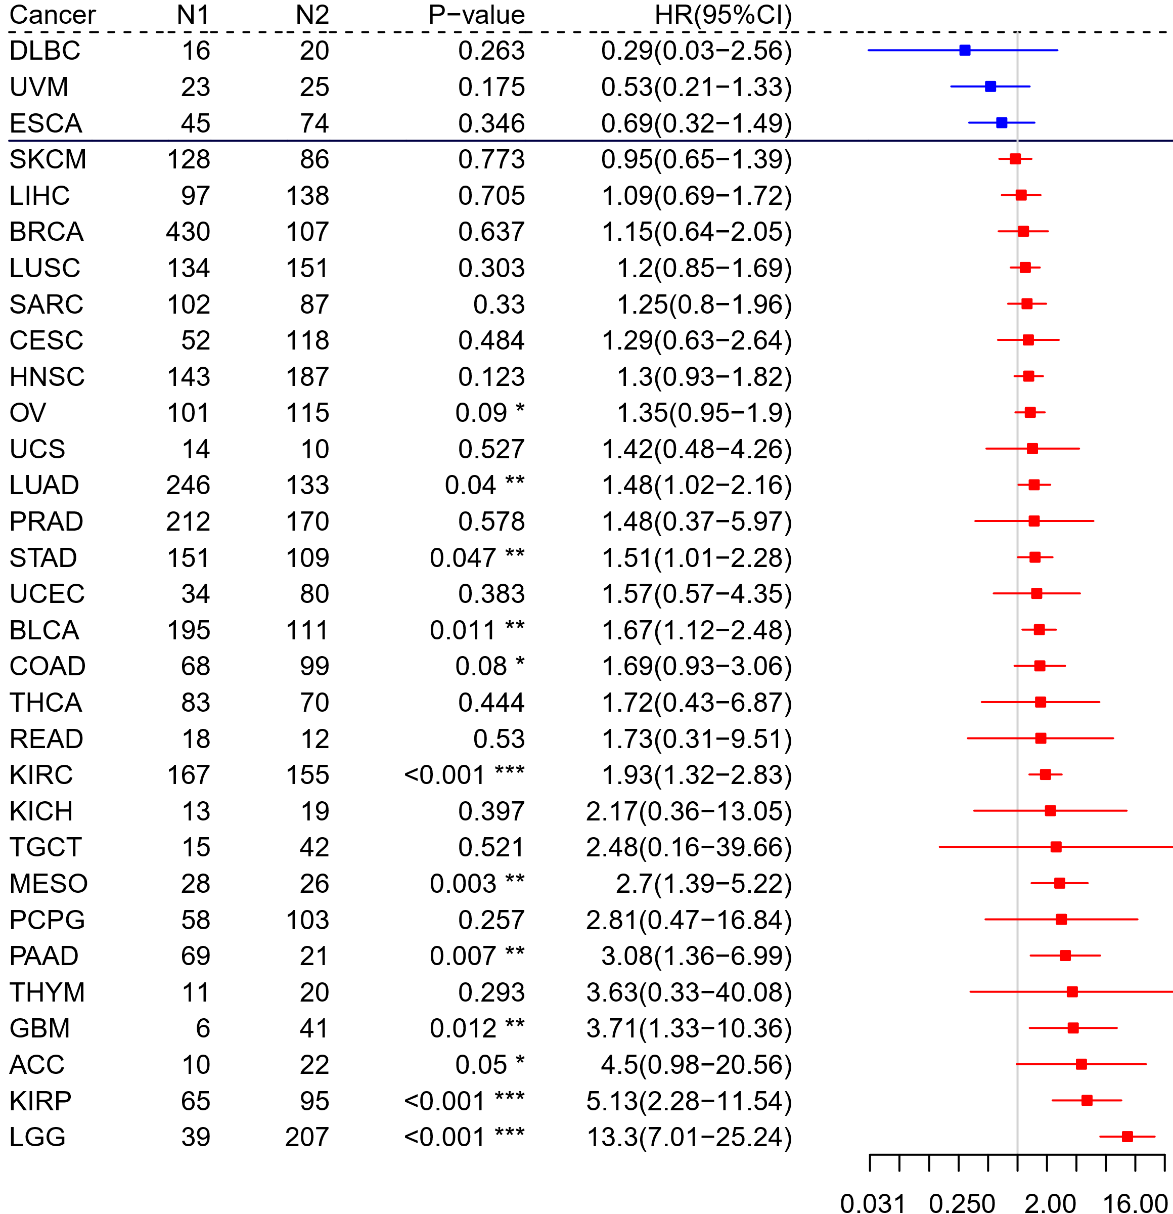
A
Consensus Clustering
B
Expression of Invasiveness genes for BLCA
Figure 1: A) Consensus Clustering based on Invasiveness gene set. B) Expression of Invasiveness genes in BLCA cancer. C) Invasiveness score distribution in INV High, Low and Medium groups identified by Consensus Clusters. D) Differential association of Invasiveness phenotype (INV High vs INV Low) with survival prognosis in TCGA patients.
C
D
INV High Better
INV High Worse

Slide 4
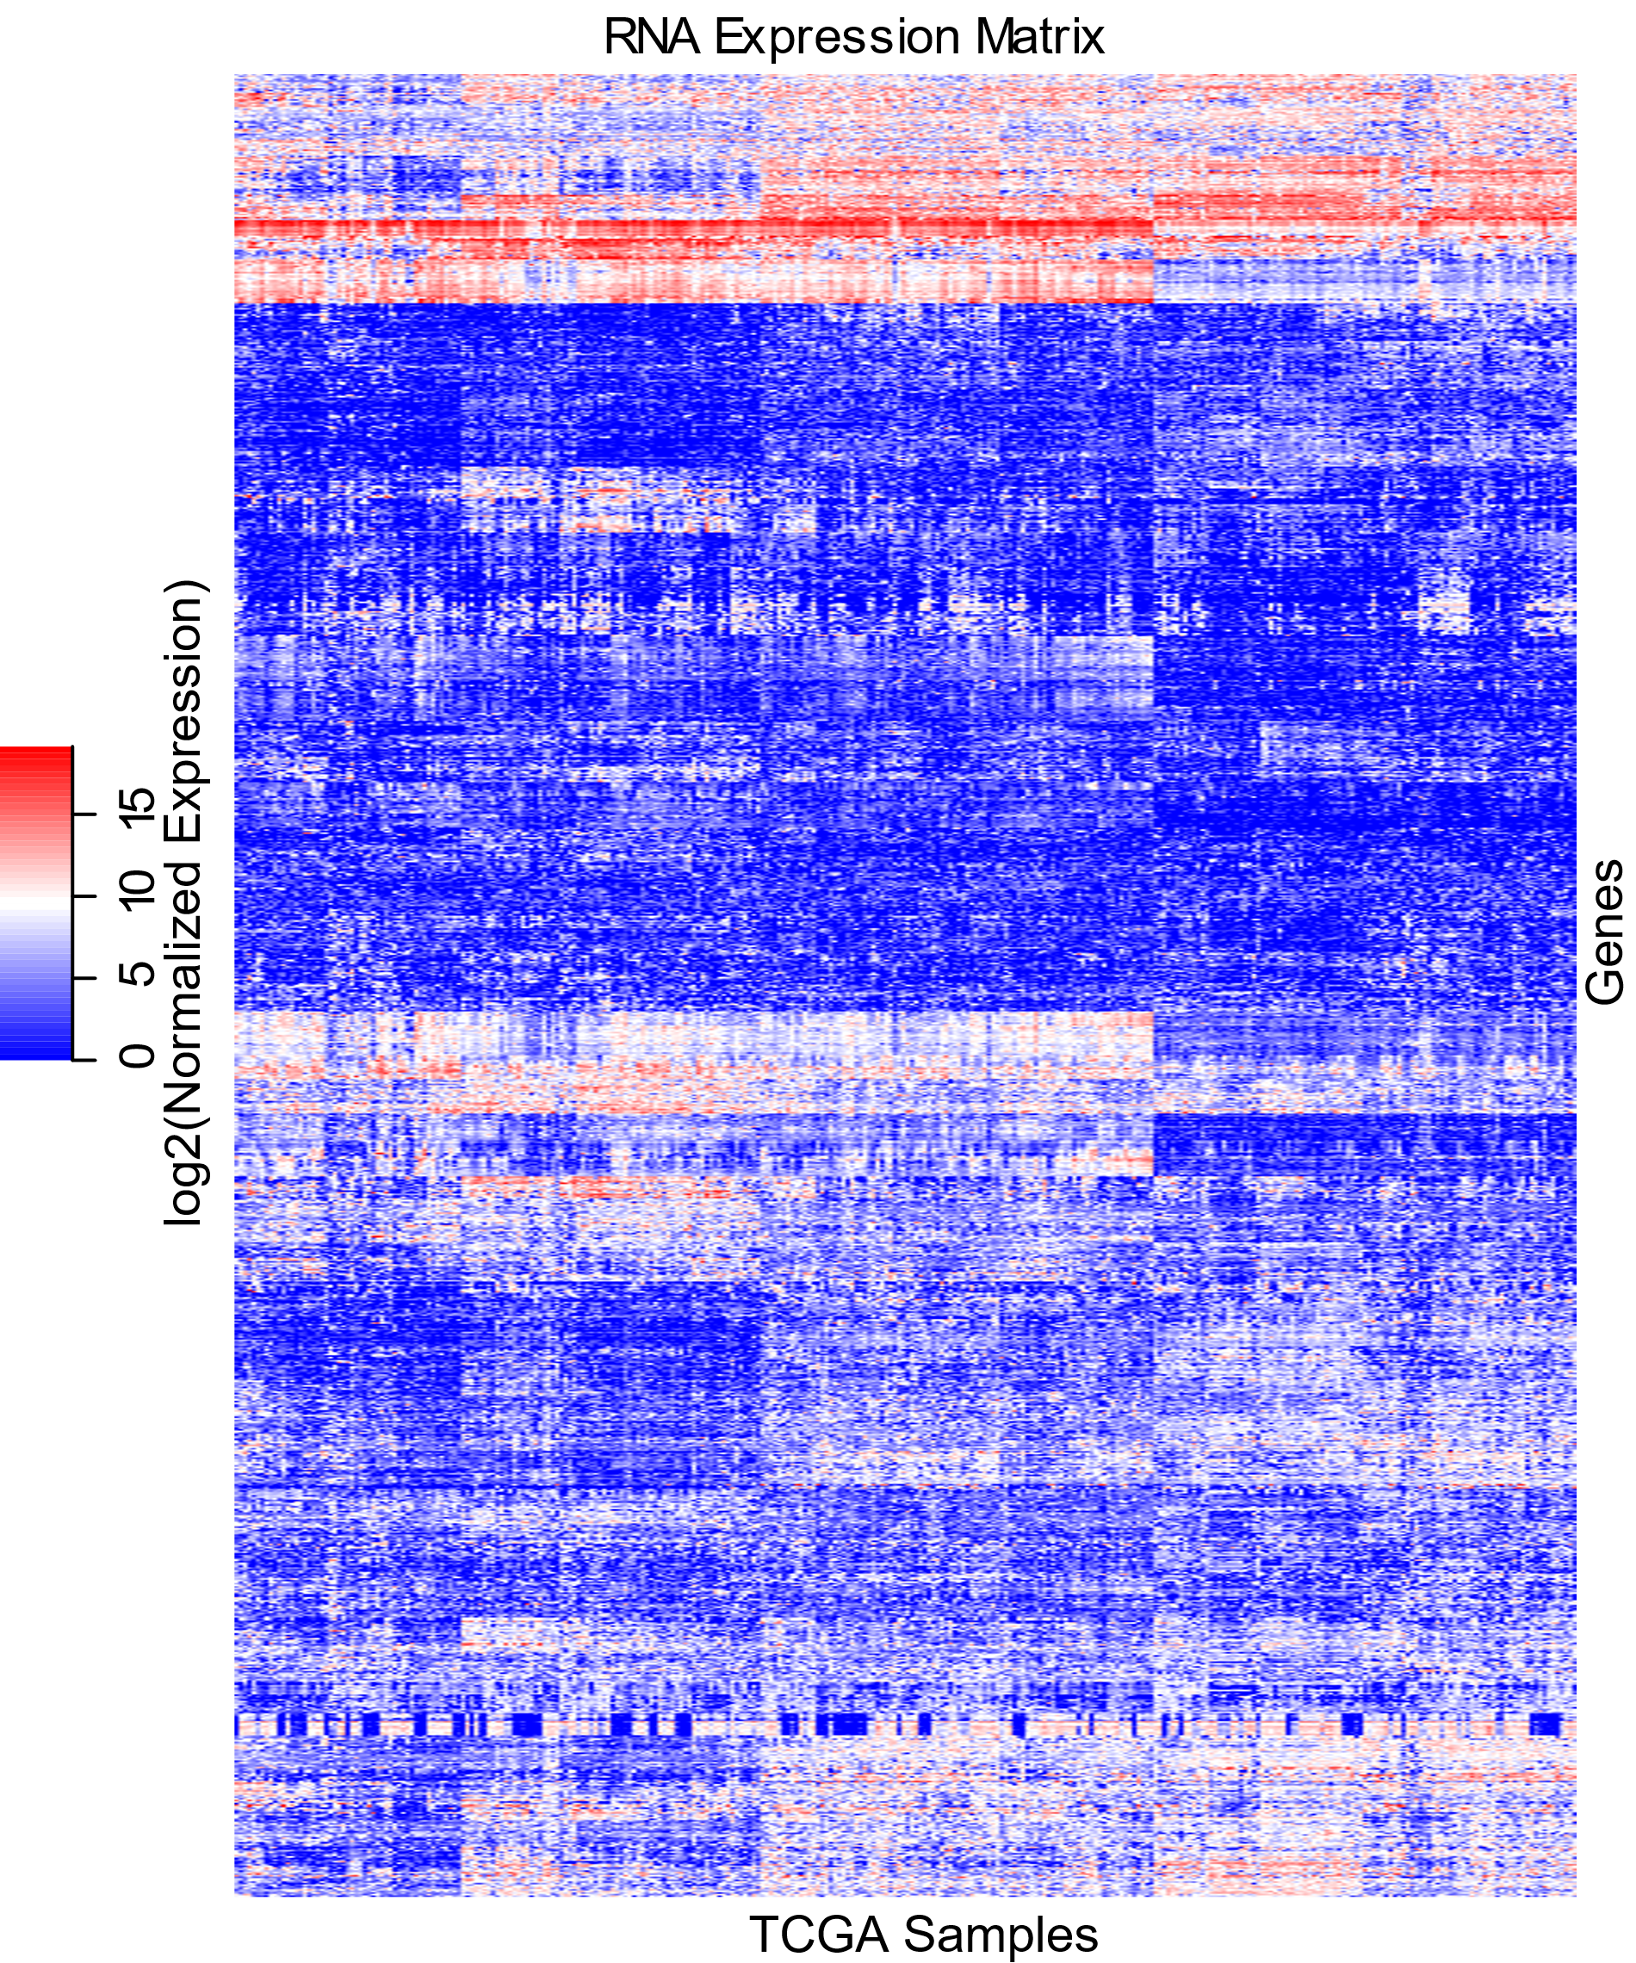
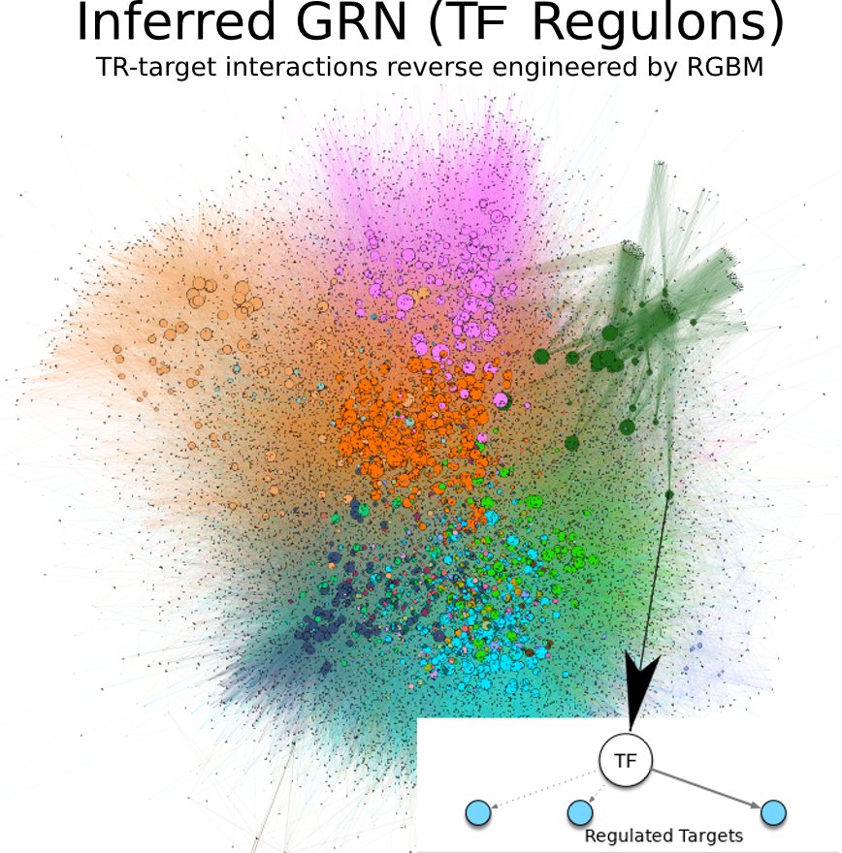
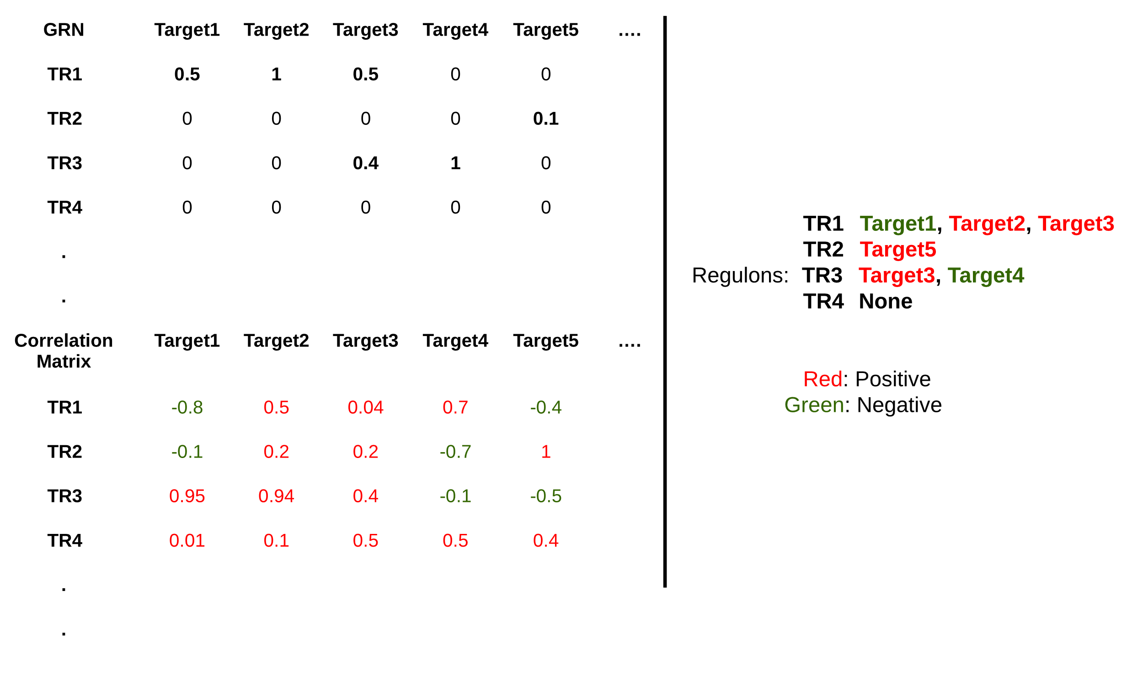
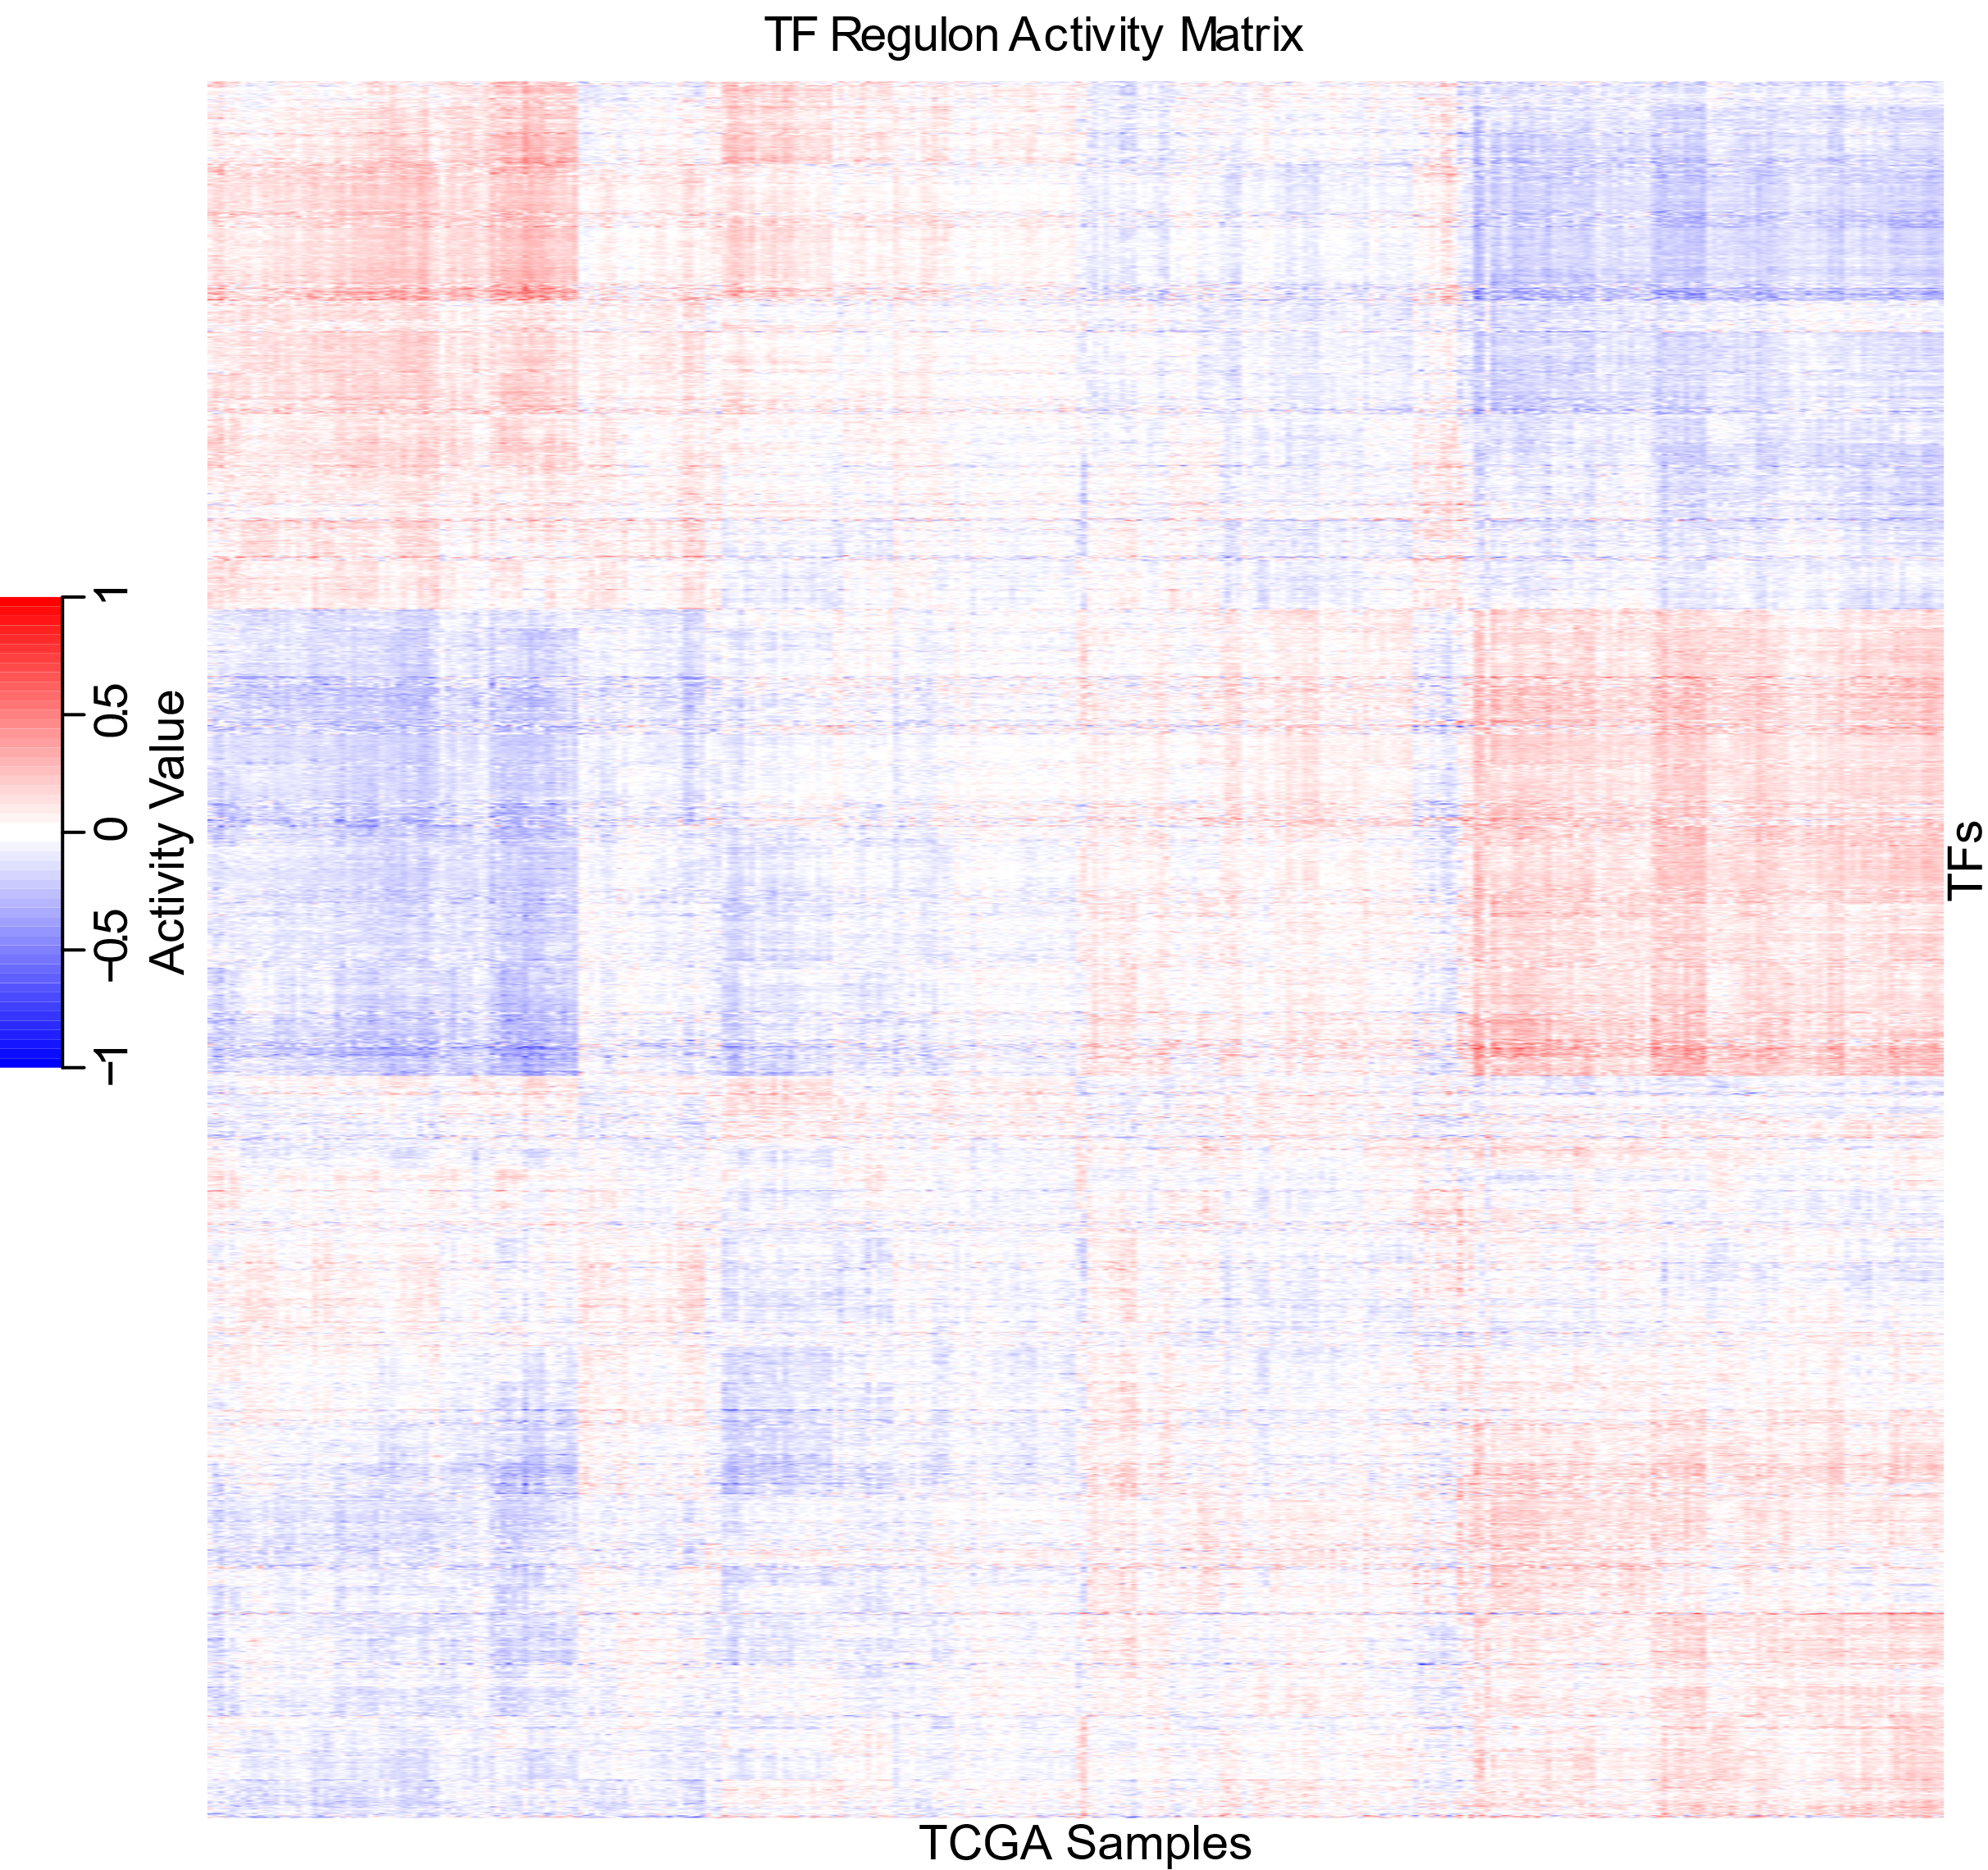
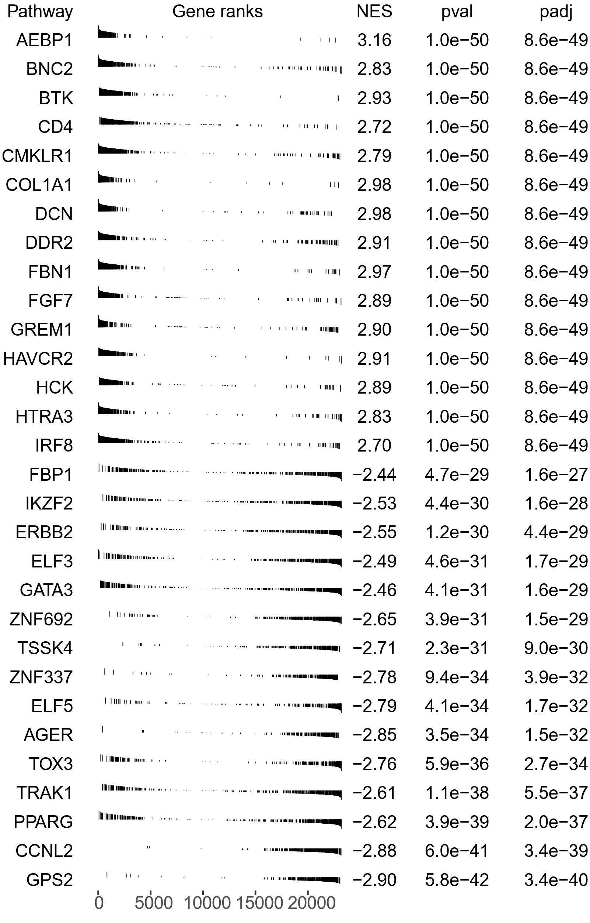
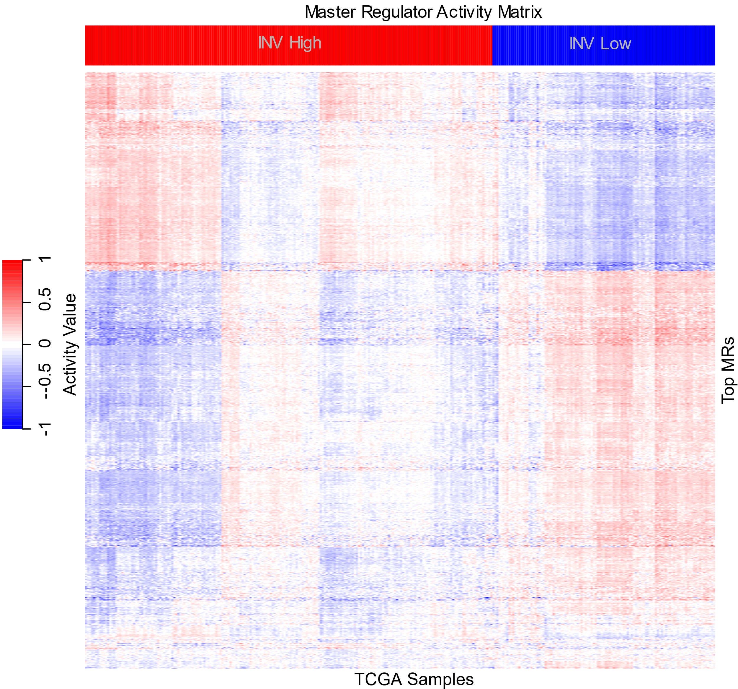
A
B
C
D
E
F
Figure 2: Master Regulator Analysis Pipeline for a Pancancer Invasiveness Phenotype

Slide 5
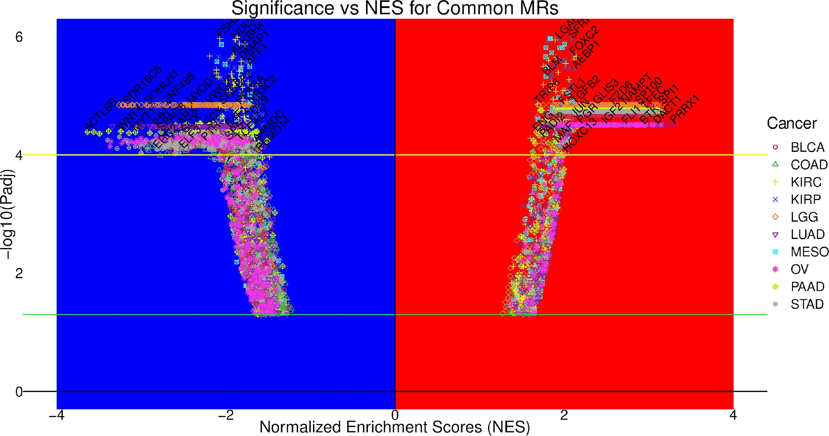
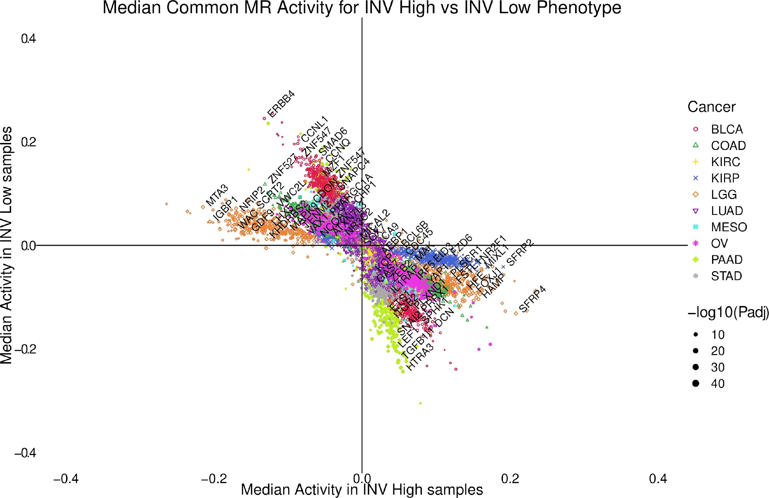
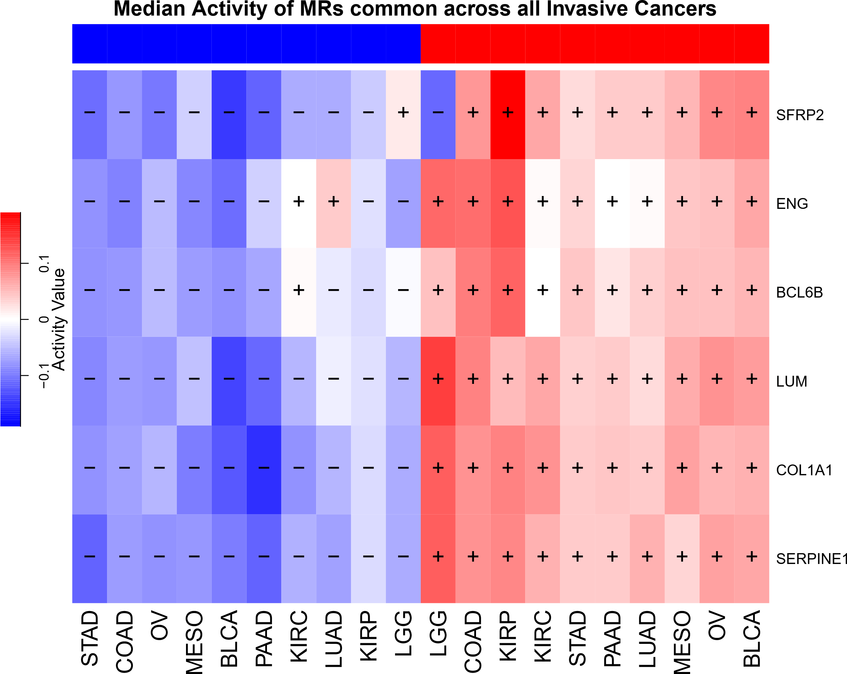
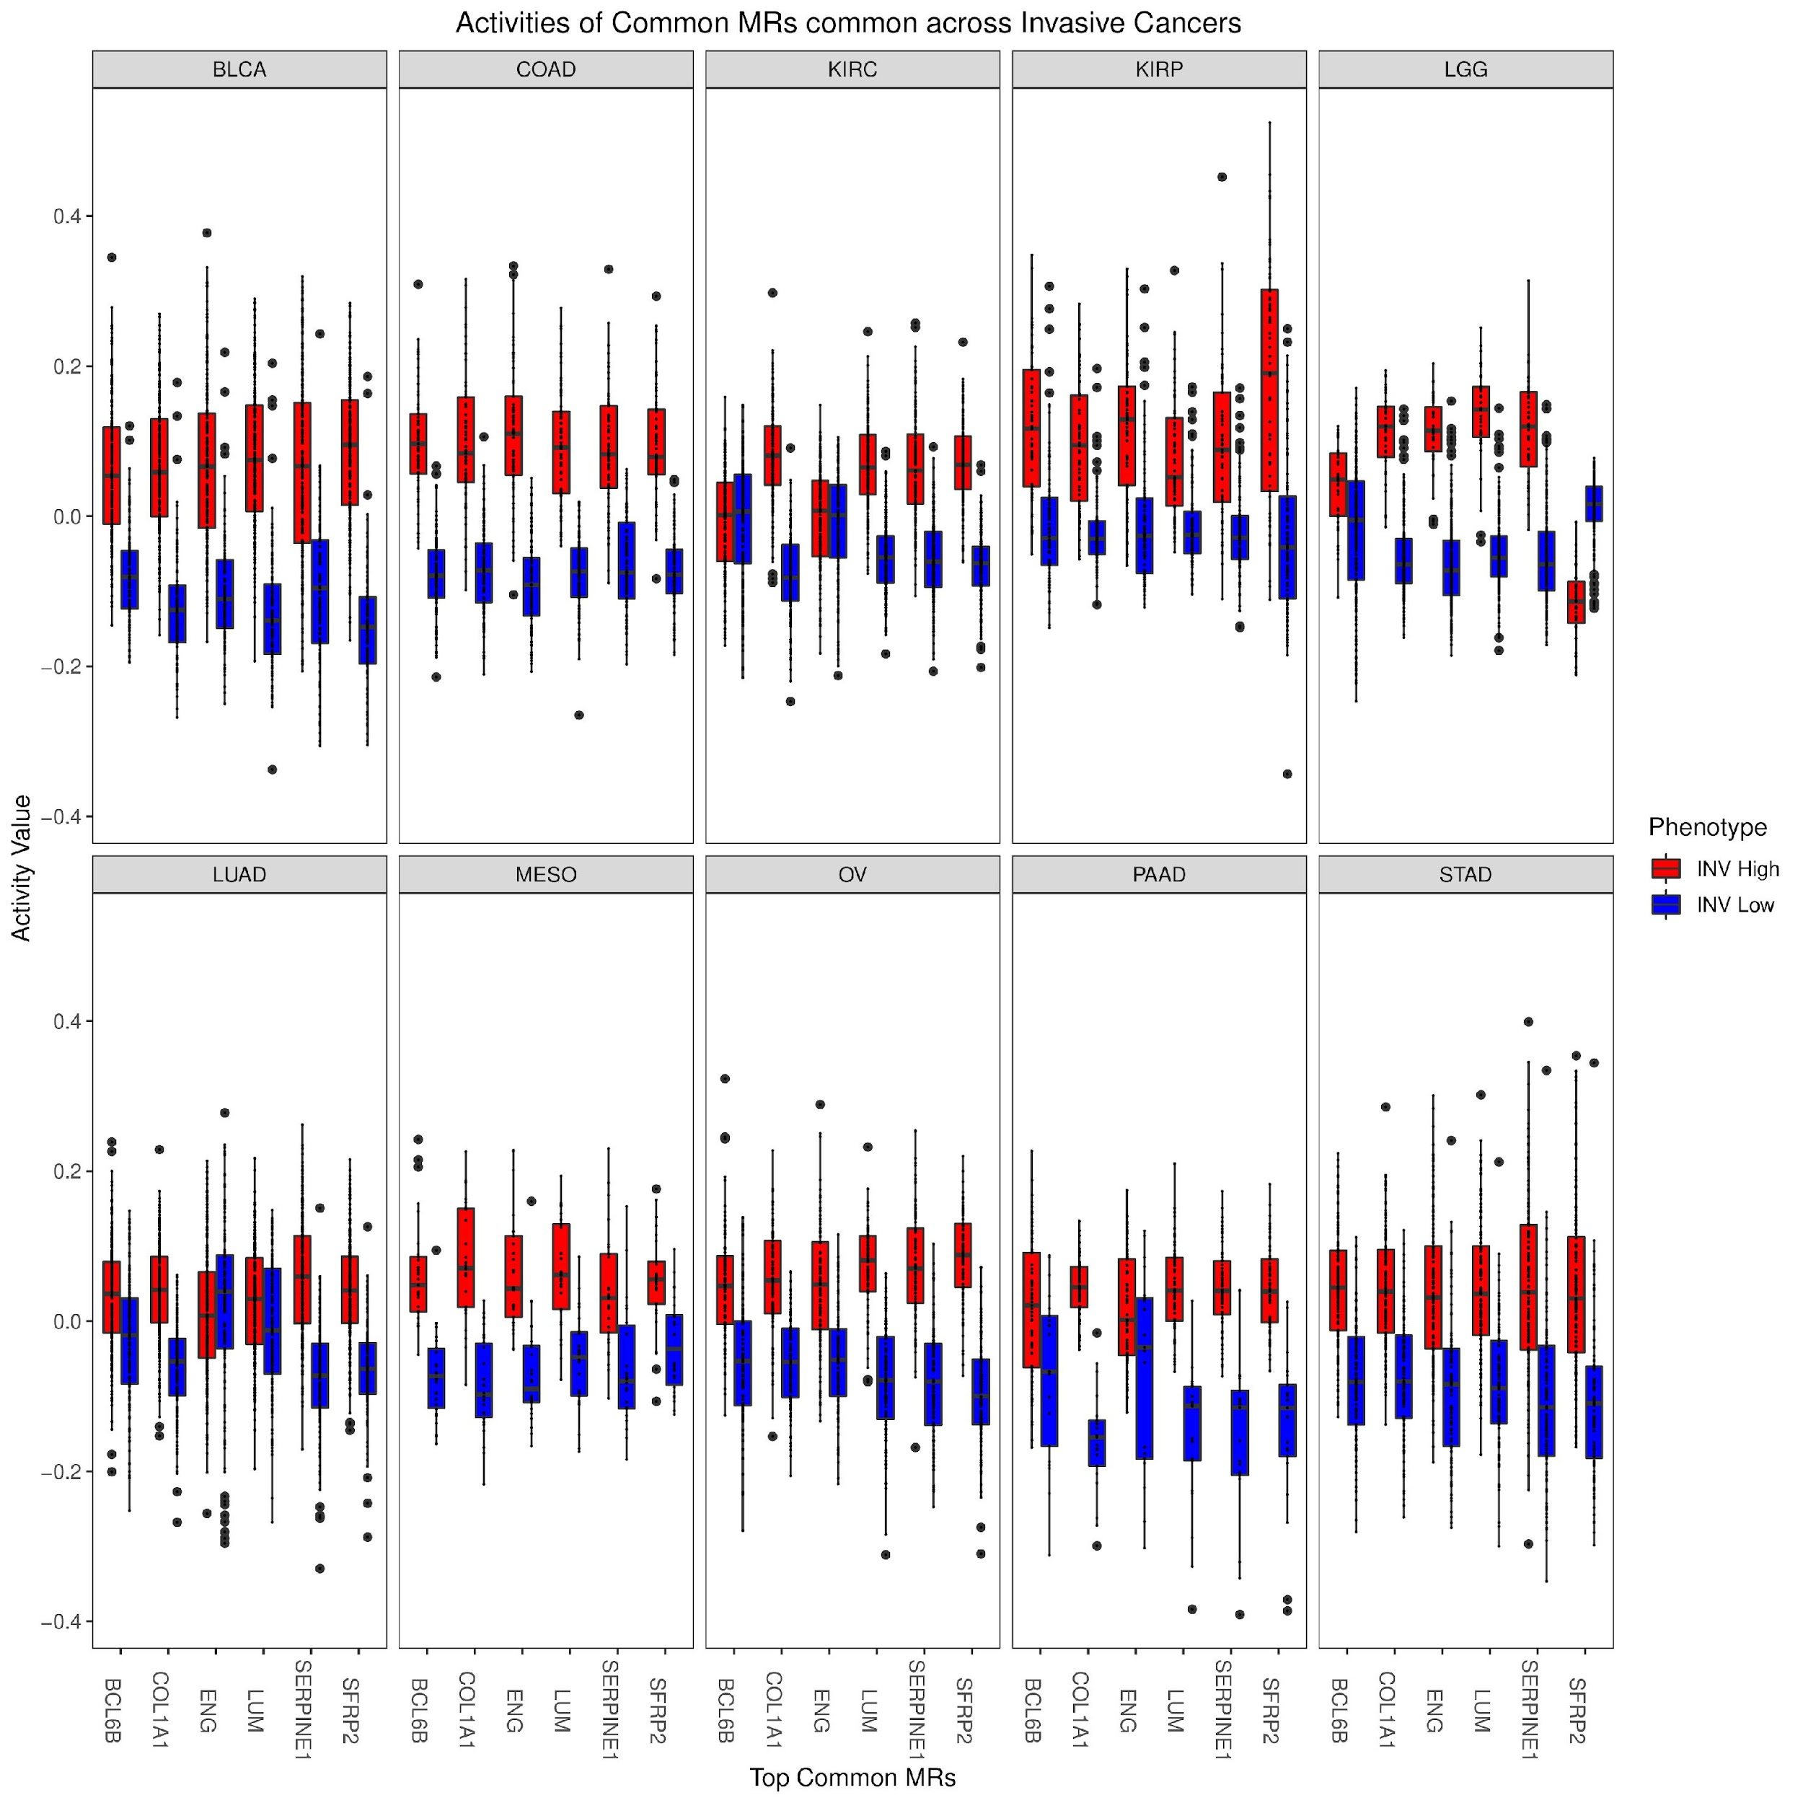
A
B
C
D
Figure 3: Top MRs common across all the 10 cancers where invasiveness has a significant prognostic impact

Slide 6
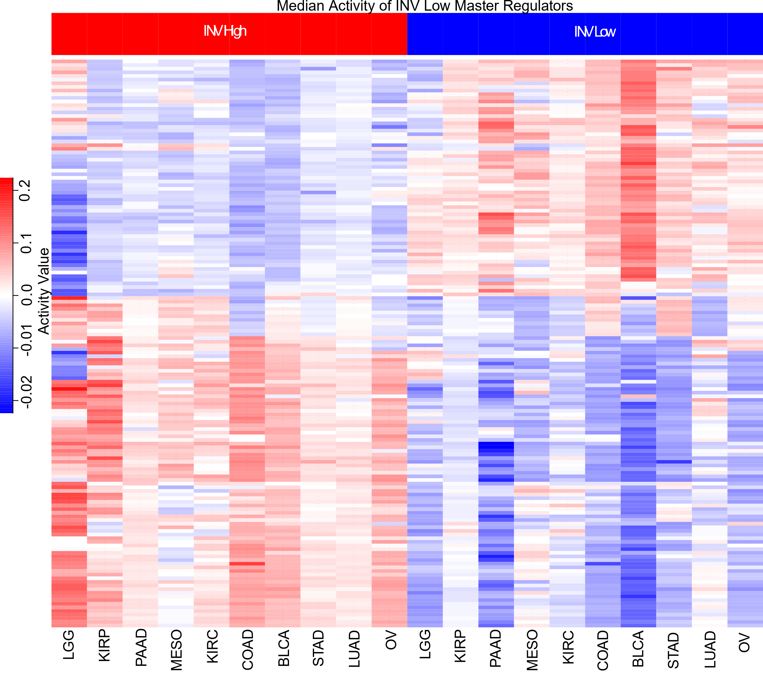
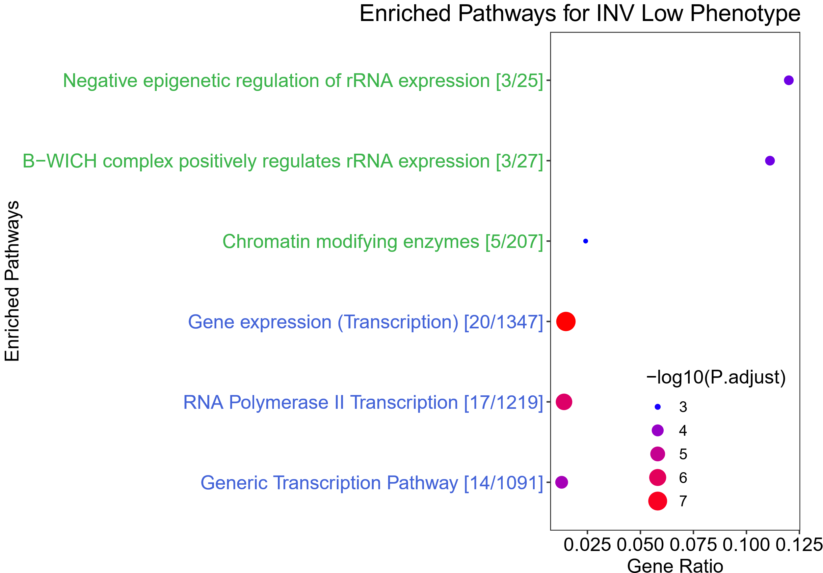
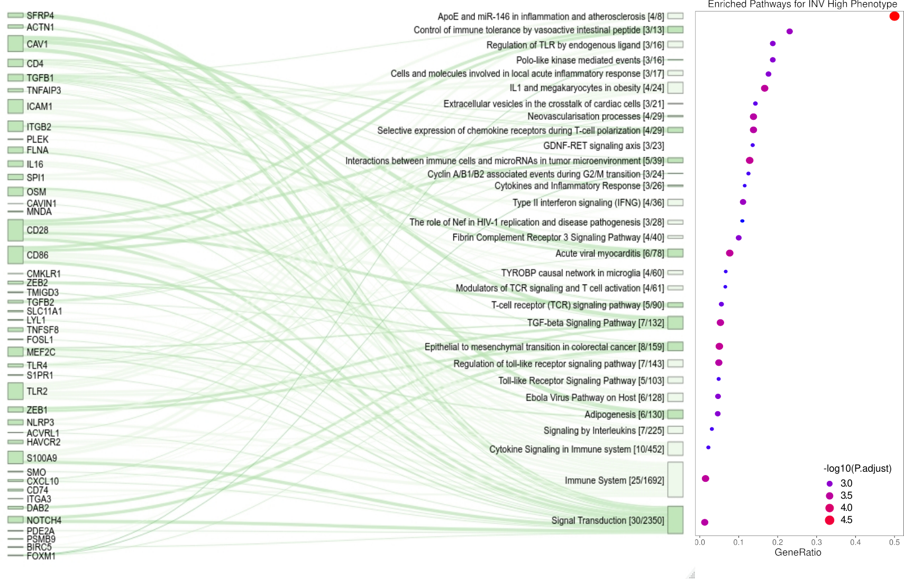
A
B
C
Figure 4: Top MRs specific to INV High/Low phenotype (MR in >5 out of 10 cancers). Pathways associated with INV Low and INV High specific MRs.

Slide 7
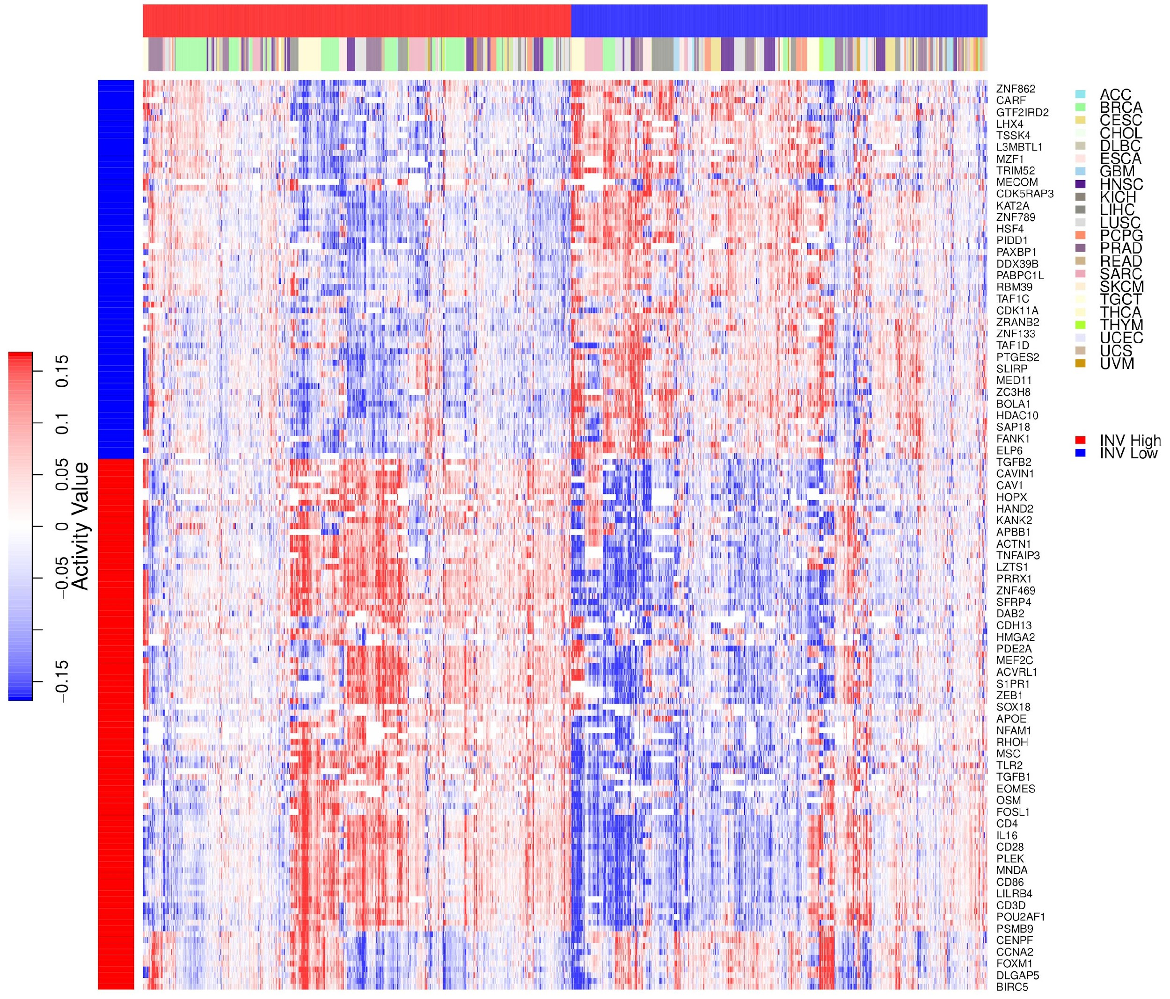
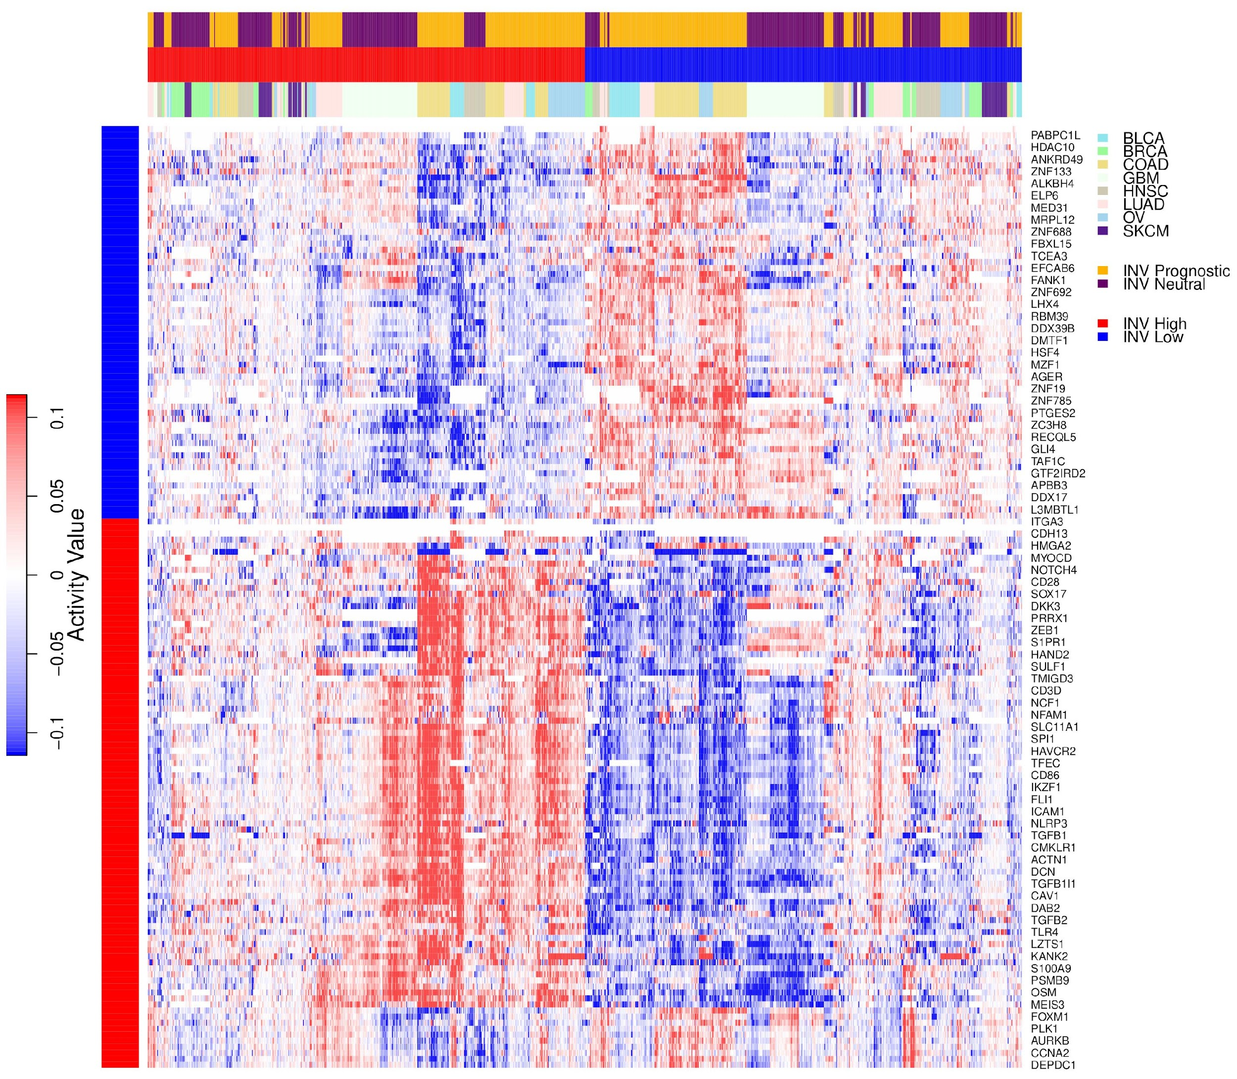
A
Figure 5: Validation of INV High and INV Low specific MR activity in cancers where INV is not prognostic. Independent validation of INV High and Low specific MR activity in datasets obtained from PRECOG repository
B

